Slide 1


SAP UI5 & FIORI
Security Information
www.zarantech.com
© Copyright 2021, ZaranTech LLC. All rights reserved.

Slide 2

Disclaimer
2
This presentation, including examples, images, and references are provided for informational purposes only.
Complying with all applicable copyrights laws is the responsibility of the user.
Without limiting the rights under copyright, no part of this document may be reproduced, stored or introduced into a retrieval system, or transmitted in any form or by any means.
Credits shall be given to the images taken from the open-source and cannot be used for promotional activities.
© Copyright 2021, ZaranTech LLC. All rights reserved.

Slide 3
Agenda
3
Security Information for SAPUI5
Getting Started with SAPUI5
© Copyright 2021, ZaranTech LLC. All rights reserved.

Slide 4

SAP UI Development Toolkit for HTML5
2
Overview
SAP UI5 is the development tool from SAP toolkit, offering various features that the users can use to enhance their user experience to create apps with rich user interfaces for Web business applications.
‹#›

Slide 5

Overview of SAP UI5 & Fiori
2
Security Information for SAP UI5
SAPUI5 is a client-side JavaScript library.
Unlike WebDynpro, the application is built against an abstract programming model and the framework handles the HTML rendering JavaScript code and communication with the browser, in SAPUI5 the application controls the HTML output.
It provides own JavaScript code which is executed on the client and it handles client/server communication.
‹#›

Slide 6
Overview of SAP UI5 & Fiori
2
Security Information for SAP UI5
Common security mechanisms like user authentication, session handling, authorization handling or encryption are not part of SAP UI5.
This need to be handled by the server-side framework and/or custom code of the application.
‹#›

Slide 7
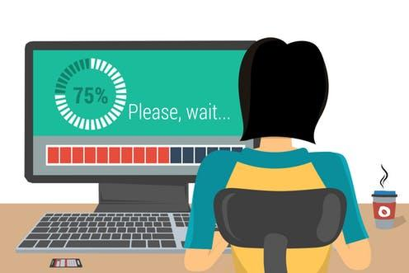
Developing Applications using SAP UI5
2
Lets see, Creating your First SAP UI5
Application
13
© Copyright 2021, ZaranTech LLC. All rights reserved.

Slide 8
Developing Applications using SAP UI5
2
Lets see, Creating your First Mobile SAP UI5 Application
13
© Copyright 2021, ZaranTech LLC. All rights reserved.

Slide 9
Developing Applications using SAP UI5
2
Lets see, Developing your First Application using SAP UI5 Tools
13
© Copyright 2021, ZaranTech LLC. All rights reserved.

Slide 10
Developing Applications using SAP UI5
2
Lets see, Testing SAP UI5 Application
13
© Copyright 2021, ZaranTech LLC. All rights reserved.

Slide 11
Thank you
Subscribe to our Channel for more Informative Videos.
https://www.youtube.com/user/ZaranTech

